Slide 1

Why Data Visualization is critical to Your Organization

Slide 2
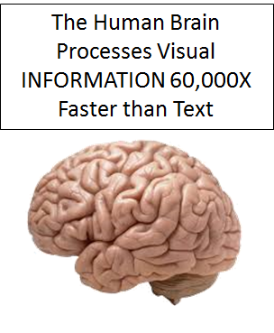
Data Visualization is a graphical representation of the information collected through data analysis. The data can give you the clear insight when it is been shown in visual context through Map/Graphs
When it comes to Turing your data into tangible action for your organization for first step is data visualization. Because if you want to take a step forward, you must be able to see big picture behind your data.
Below are the list of reason why it is critical to your Organization

Slide 3
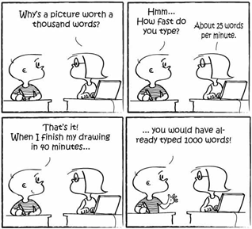
Data visualization conveys your Message
Turning data analysis into visual representations such as charts, graphs, and histograms to more easily consume data.
The image clears says Visual and Picture are more attractive and more powerful to express the story to the audience. This is because visuals are more strongly tied to memory.
It can bring value add when your organization's data have been shown in visualization and gives the clear picture of the story for decline or gain.
Why It’s Critical: Amplifying your organizational story isn’t accomplished with just any form of data visualization, though. In order to be most effective, you need to utilize the correct chart or display for the situation. Choosing the wrong data visualization might overwhelm or confuse your audience – achieving the opposite of your intended result.

Slide 4
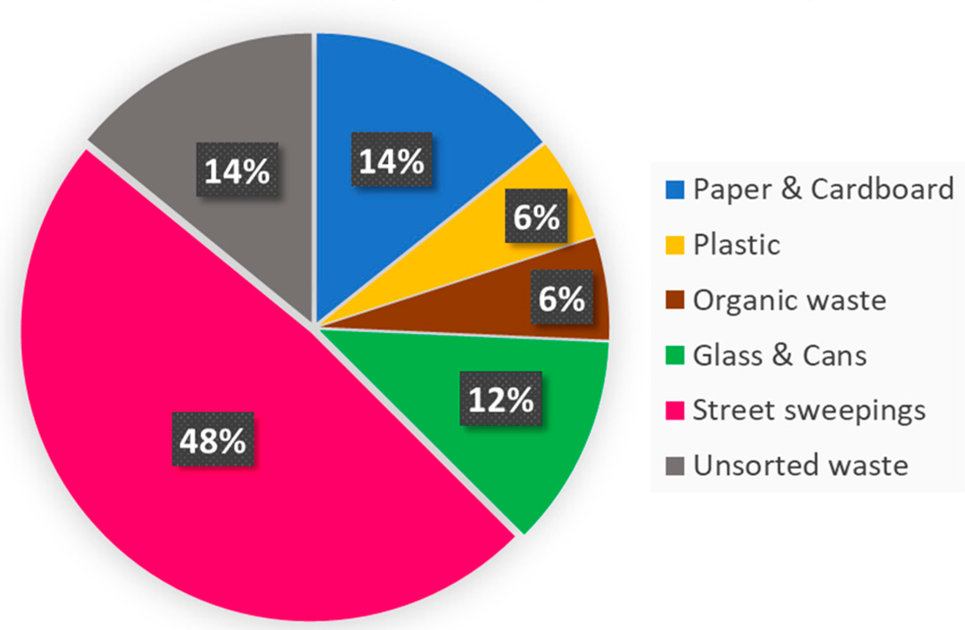
Identify areas that need attention or improvement
Data visualization will not only help us to share our organization's story to the audience, but it will also help us to improve or identify the area that need attention.
The picture describes the production related waste by industry in the year 2018,
It clearly shows that 48% of the waste are from Street Sweepings which form the major part of total generated waste. This can be efficiently managed by segregating the waste into dry and wet waste so that the dry waste can be recycled, and wet waste can be used as composed.
Key decision-makers in your organization aren’t always experts in every activity of the enterprise, but with the right data visualization comparisons, these leaders are able to make quicker, more informed decisions. Just as before, beware of improper comparative visualizations – if your organizational data analysis is unclear, confusing or difficult to compare, your visualizations might be doing more harm than good.

Slide 5
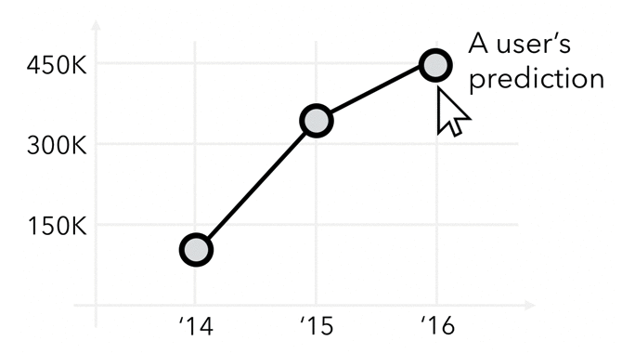
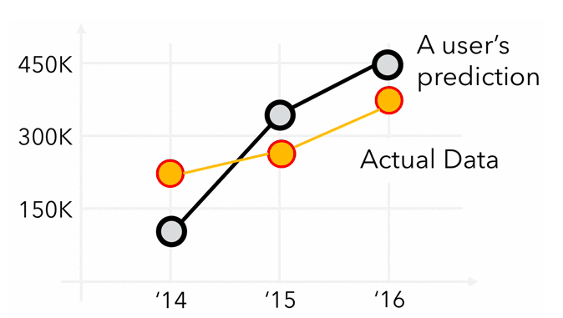
Data visualization helps to predict future
We can always see the trend which have data and we can analysis, but if our data can tell us how the future looks like so that we can be prepared or make some improvements.
predicting the future reliably is complex. Here’s why science shows us that there are always multiple futures.
For instance, in games that use dice if you role just 1 die that gives you 6 possible outcomes, 6 possible numbers that can come up as 6 possible futures. Role 2 dice and now you have 12 possible futures, 3 dice and you have 18 possible futures.
Why It’s Critical:

Slide 6
Thank you

